Slide 1

4CP33 - Full Semester External Project At: RKIT Software PVT. LTD.
WebPulse Stack – Uptime monitoring
Presented By:
21CP031 – Navneetkumar Thakor
Presented To:
Dr. Darshak Thakore
Mr. Kirtikumar Sharma
Mr. Parimal Solanki

Slide 2
WebPulse stack
Content
1. Problem statement
2. Literature survey
3. Introduction to solution
4. Diagrams
5. Implementation
6. reference

Slide 3
WebPulse Stack
Problem Statement

Slide 4
WebPulse Stack
Problem statement
In today's digital landscape, businesses rely heavily on their online presence to maintain customer trust and operational efficiency. They required 24/7 online presence of their website or application.
Website downtime, slow response times, and service disruptions can lead to revenue loss, damaged reputation, and poor user experience.
So, there is strong need of a system which can continuously monitor their servers, and alert them if any unwanted incident happens.

Slide 5
WebPulse Stack
Literature
Survey

Slide 6
WebPulse Stack
Literature Survey
There are few good software are already present in the market.
Uptime Kuma
Open source, self-hosted monitoring tool.
Provides support for multiple protocol support.
Multi user support
Docker-based deployment
What unique we will do compare to it?
Cloud-based monitoring system.
Scalability.

Slide 7
WebPulse Stack
Literature Survey
2) Better Stack
Cloud-based real time monitoring system.
Highly scalable
Log management
Alerting through various mediums
Monitoring through different regions
Lot’s of different ways to monitor site.

Slide 8
WebPulse Stack
Introduction
To
Solution

Slide 9
WebPulse Stack
Introduction to solution
WebPulse Stack is Cloud-based end-to-end software for real time uptime monitoring.
It is highly available and Folt tolerance system. Hence, It is highly scalable
It encompasses features like incident alerting, user dashboard for controlling their monitors etc…

Slide 10
WebPulse Stack
Diagrams

Slide 11
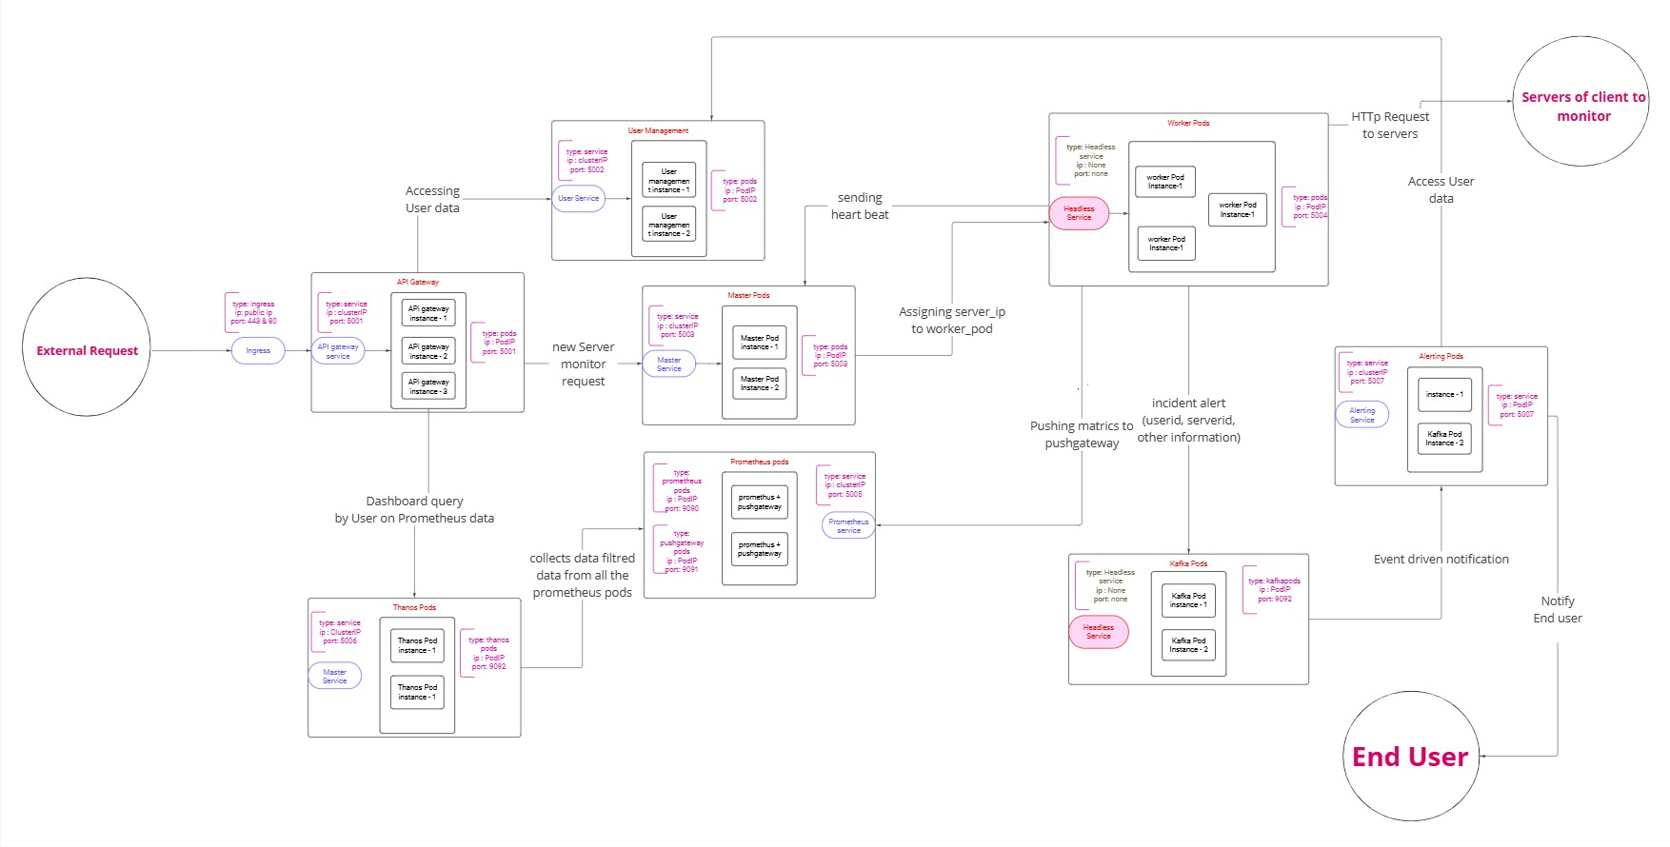
Orchestration
WebPulse Stack

Slide 12
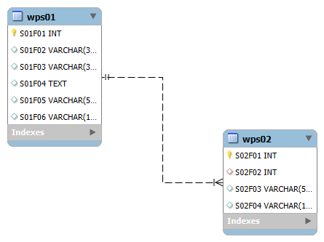
ER Diagram
WebPulse Stack

Slide 13
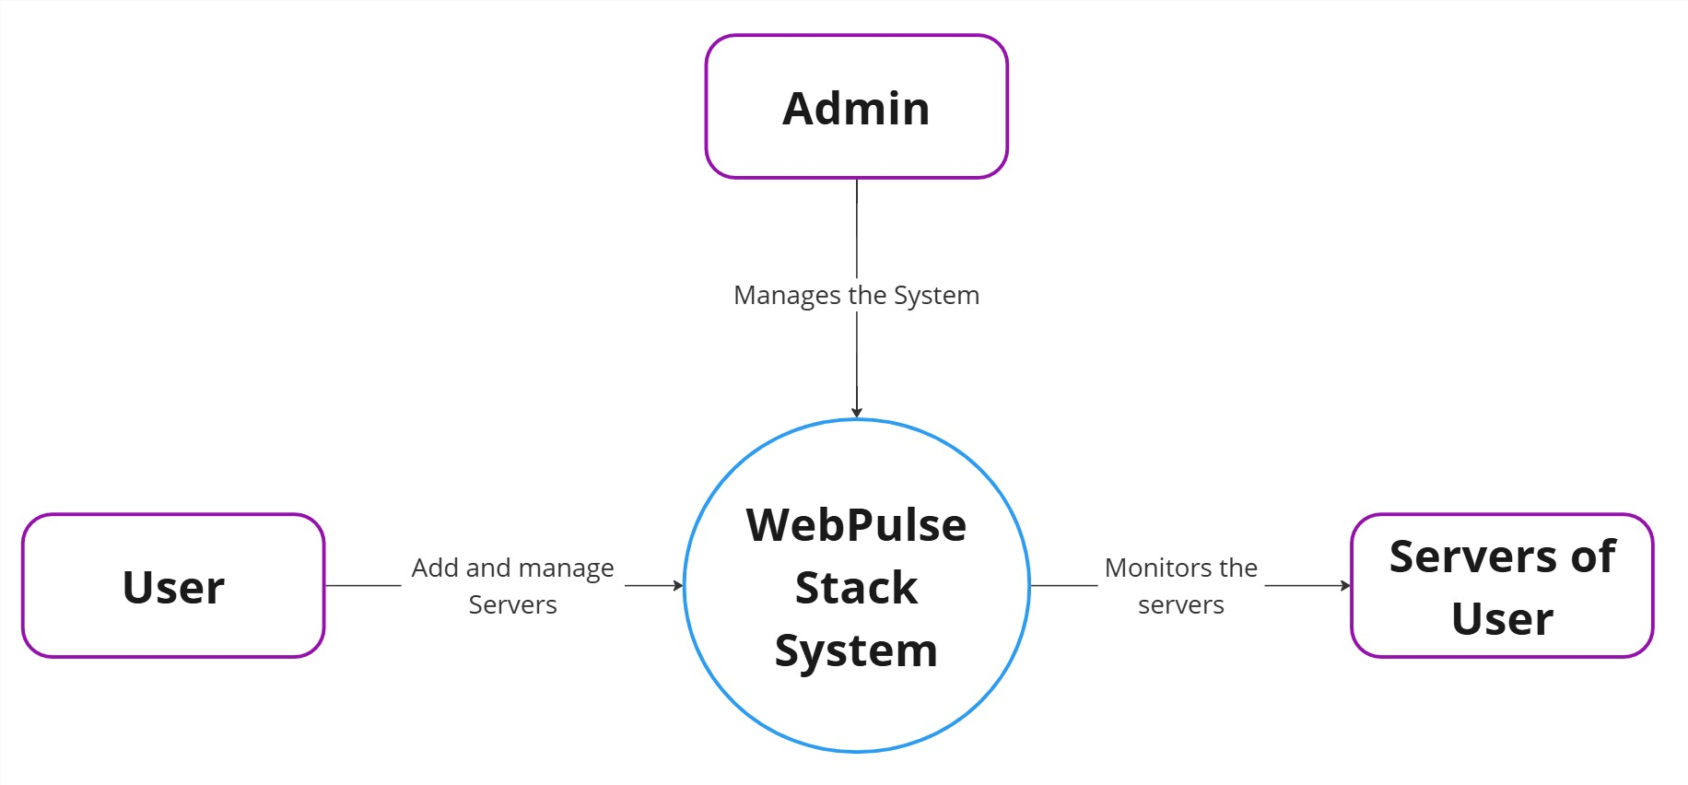
Context Diagram
WebPulse Stack

Slide 14
WebPulse Stack
Implementation

Slide 15
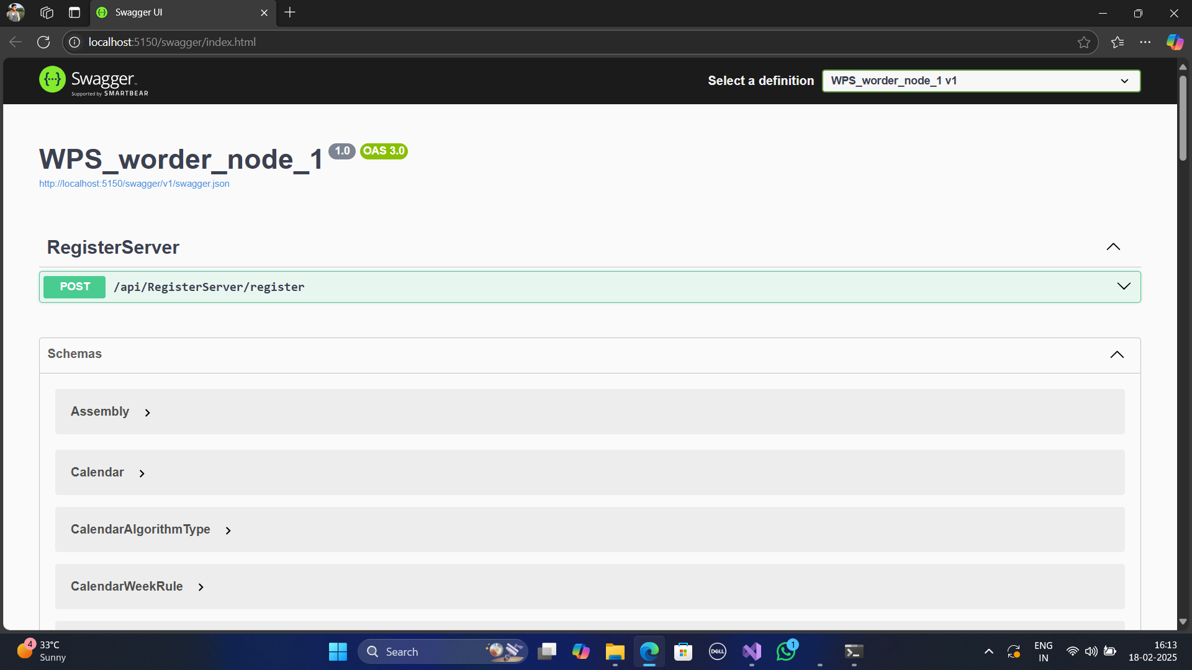
Register Servers
WebPulse Stack

Slide 16
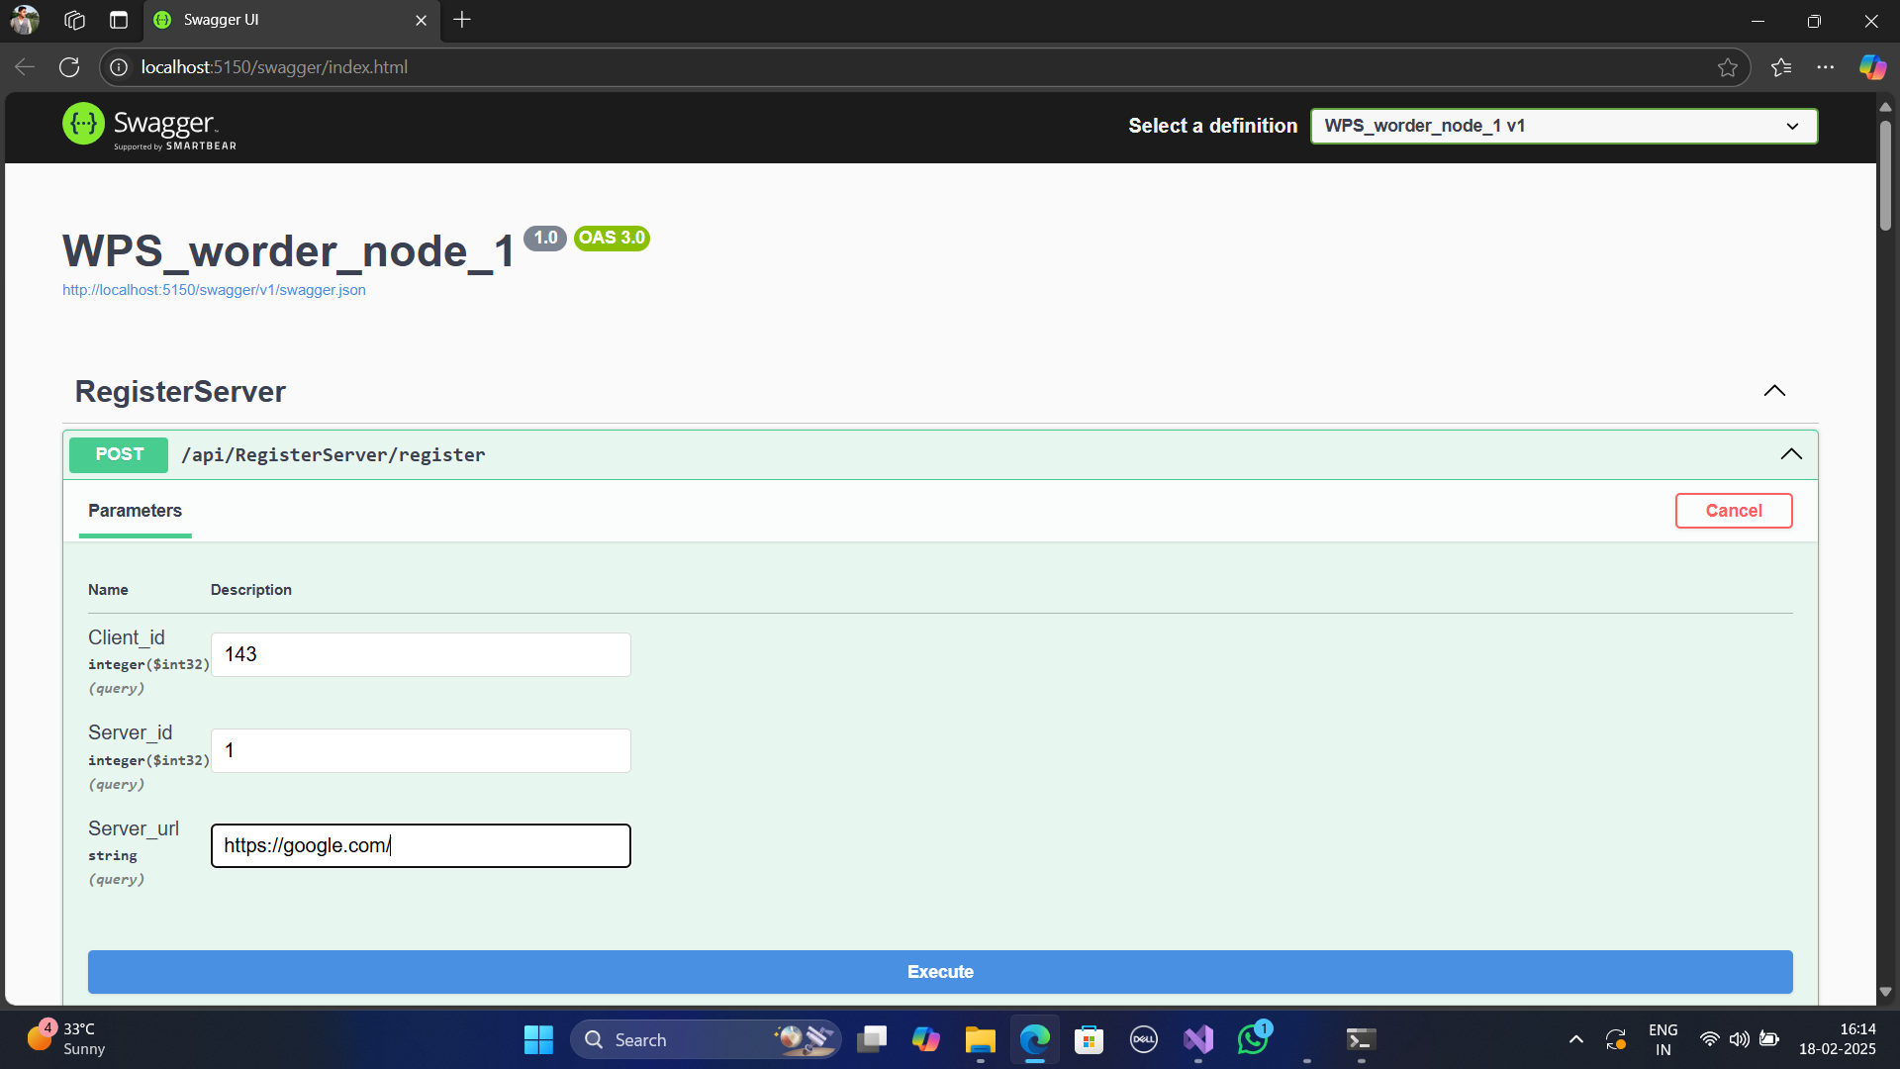
Register Servers
WebPulse Stack

Slide 17
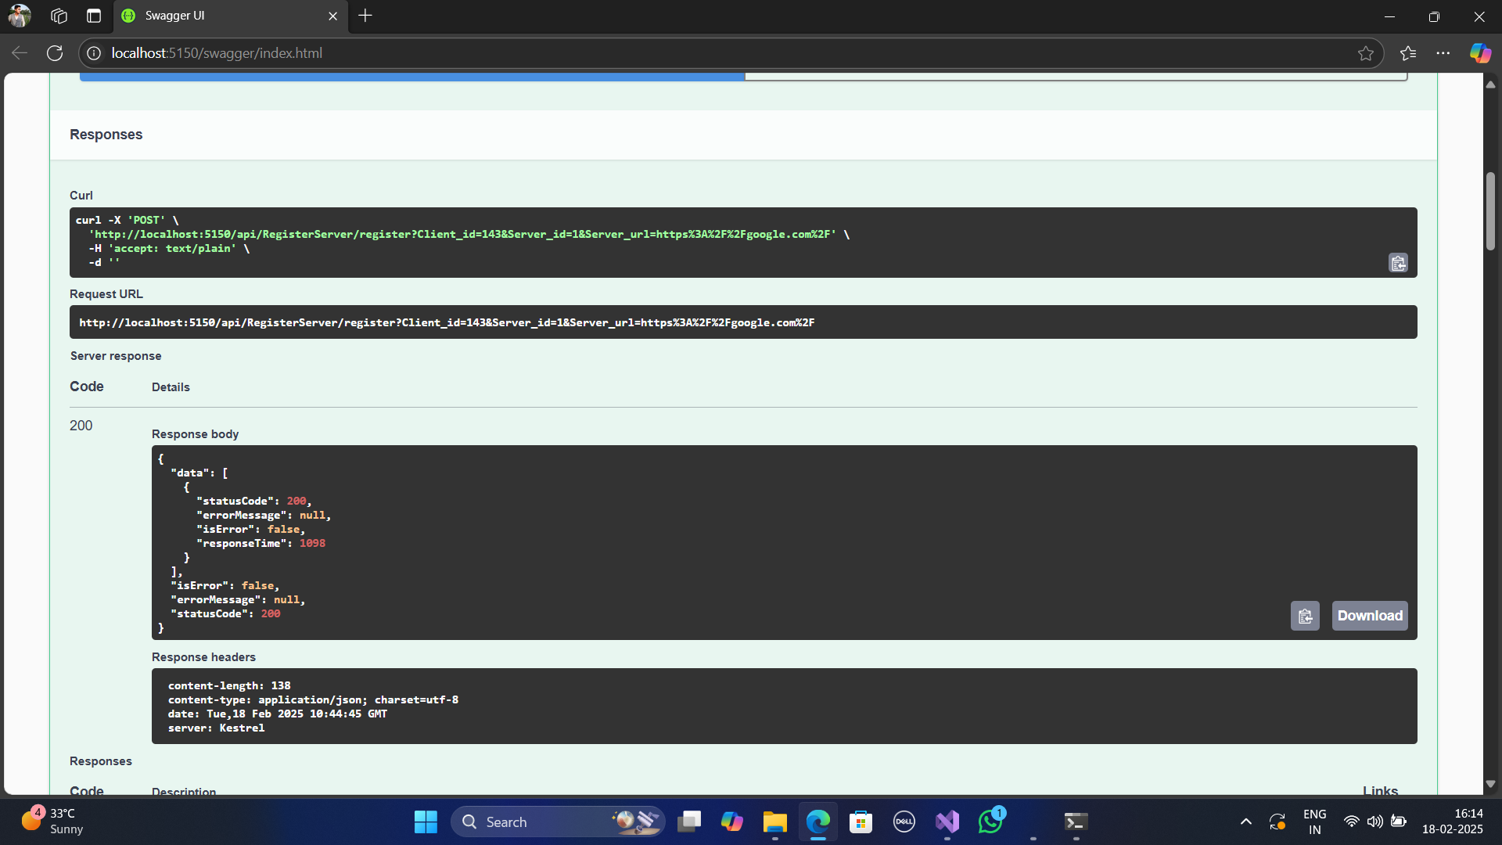
Register Servers
WebPulse Stack

Slide 18
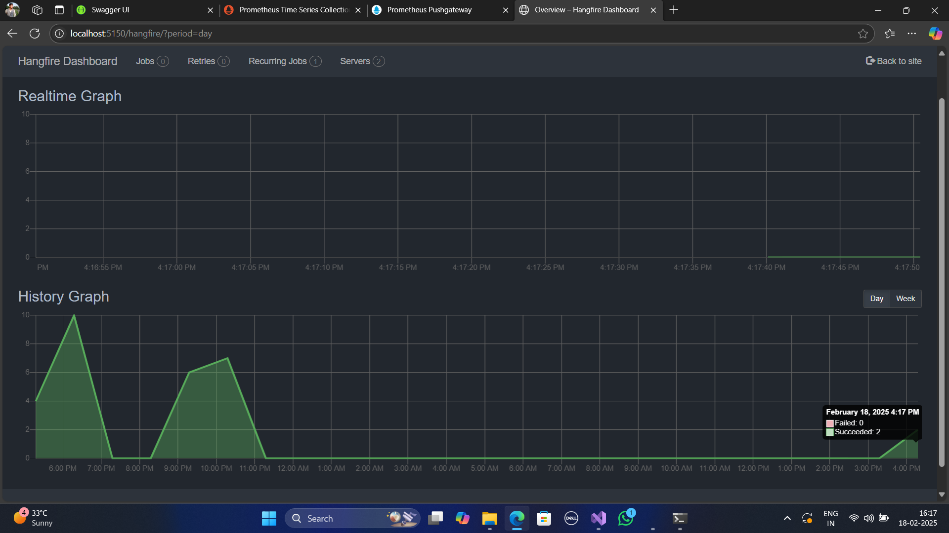
Hangfire server
WebPulse Stack

Slide 19
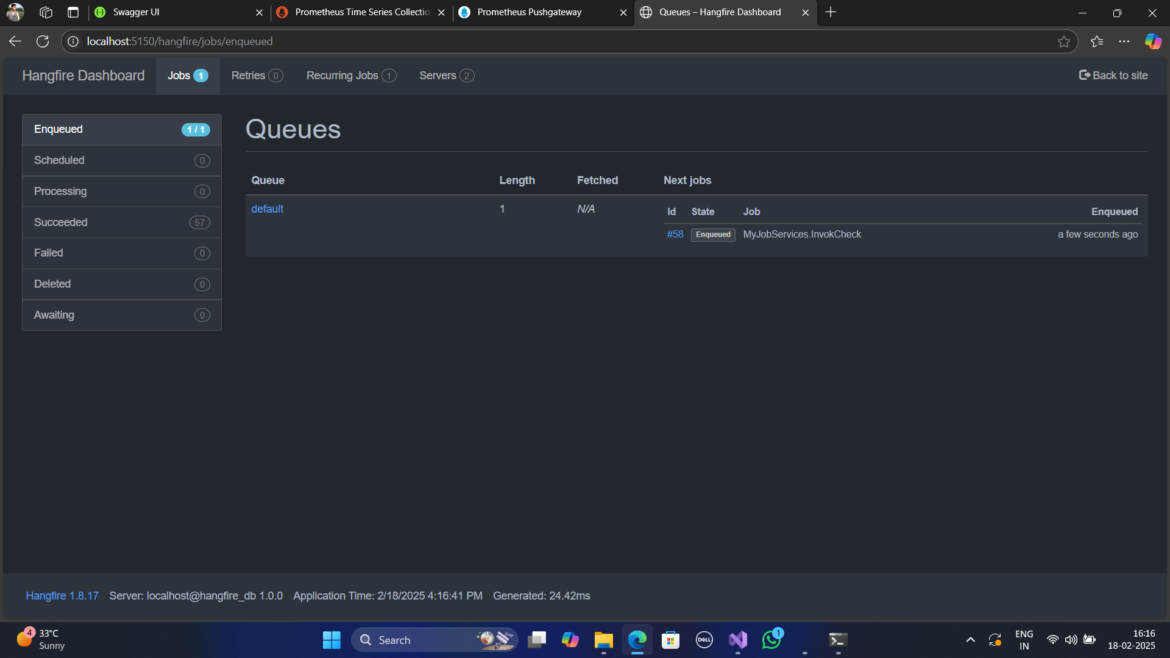
Hangfire server
WebPulse Stack

Slide 20
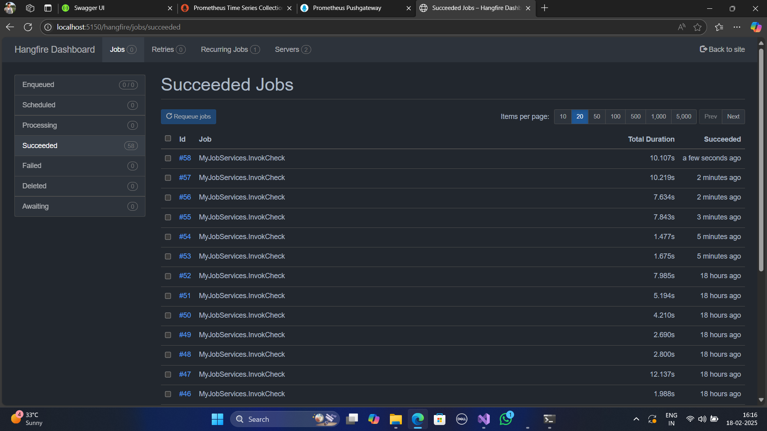
Hangfire server
WebPulse Stack

Slide 21
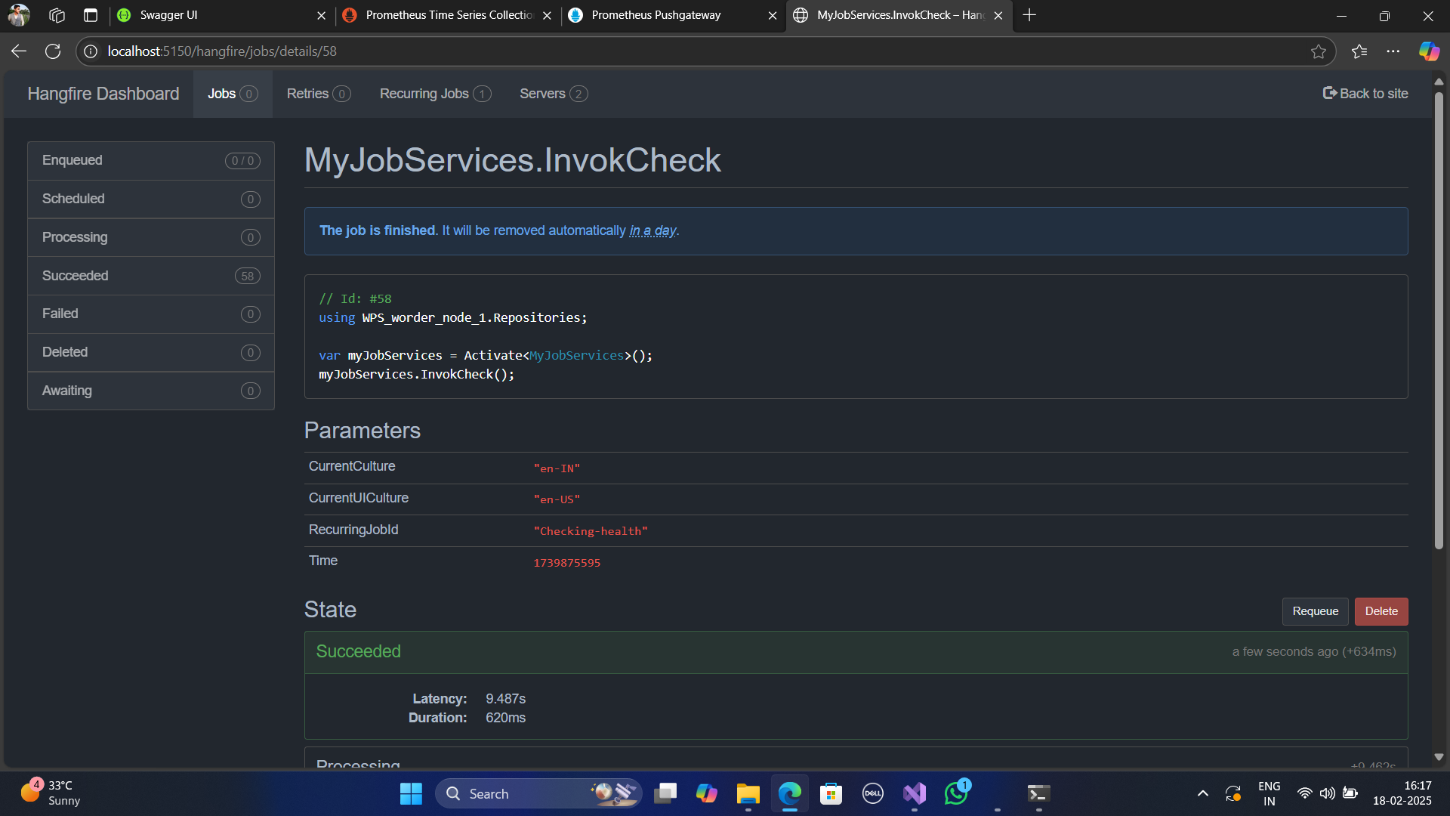
Hangfire server
WebPulse Stack

Slide 22
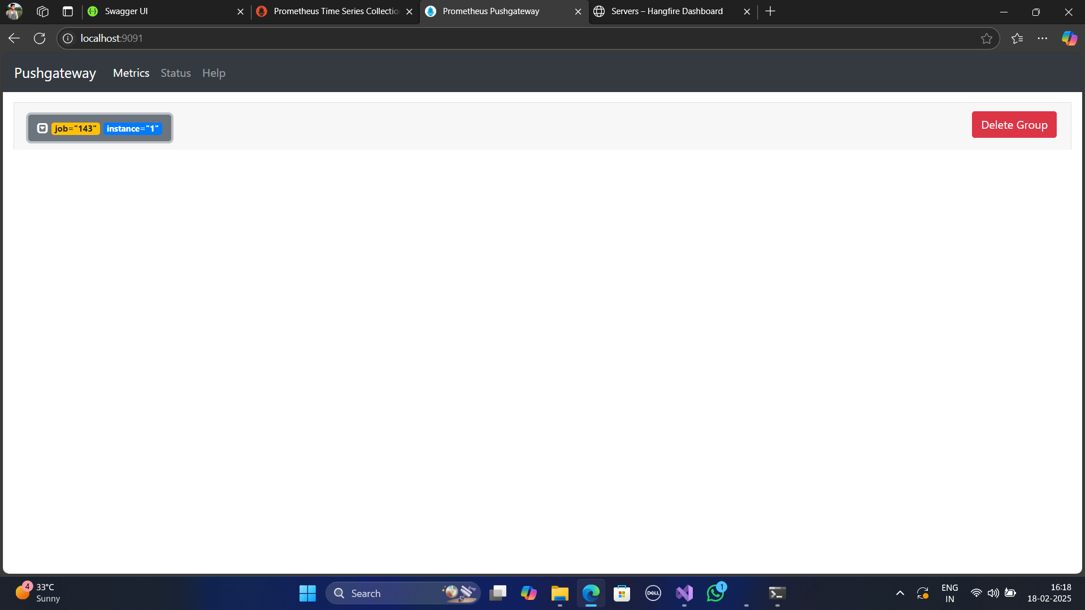
Push Gate Way
WebPulse Stack

Slide 23
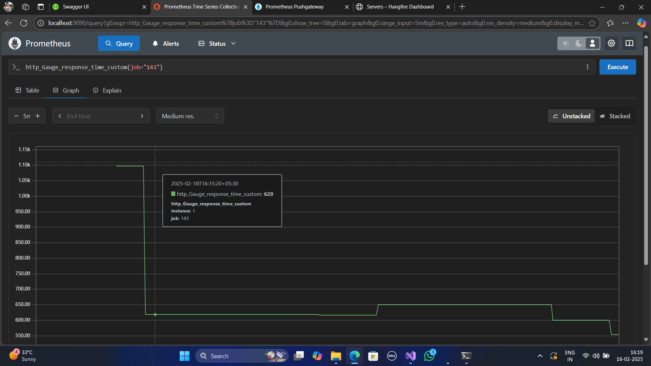
Prometheus
WebPulse Stack

Slide 24
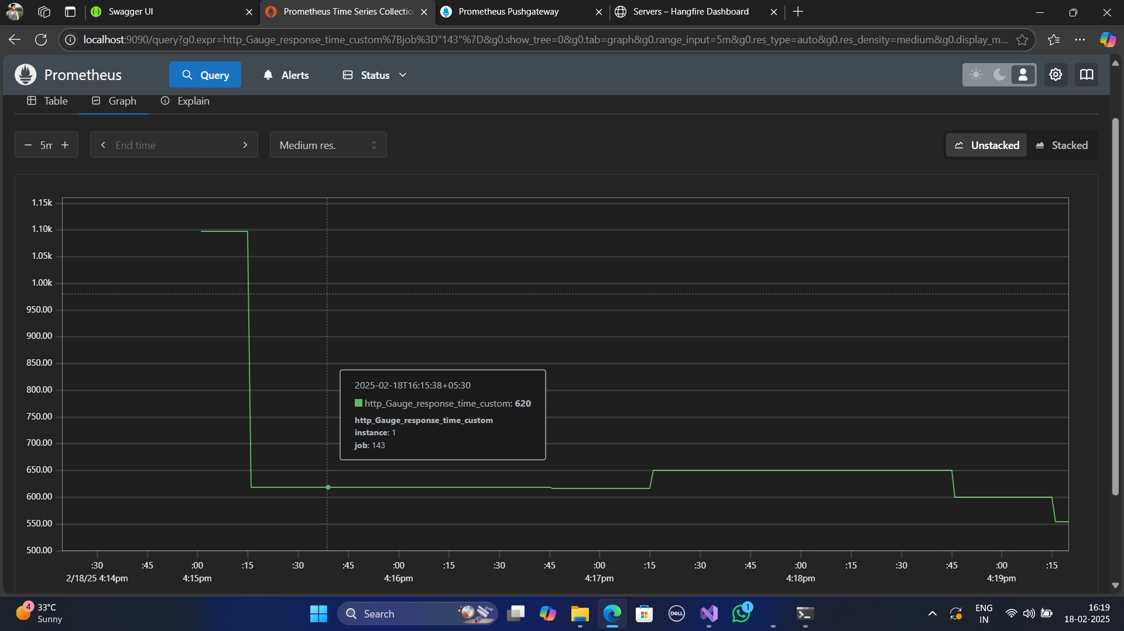
Prometheus
WebPulse Stack

Slide 25
ItemHive
References
Asp.net Core
Push-gate-way
Prometheus
Hangfire - task scheduler
Miro - tool for creating diagram
Better-stack
Uptime-Kuma

Slide 26
WebPulse Stack
Thank you!

